Slide 1
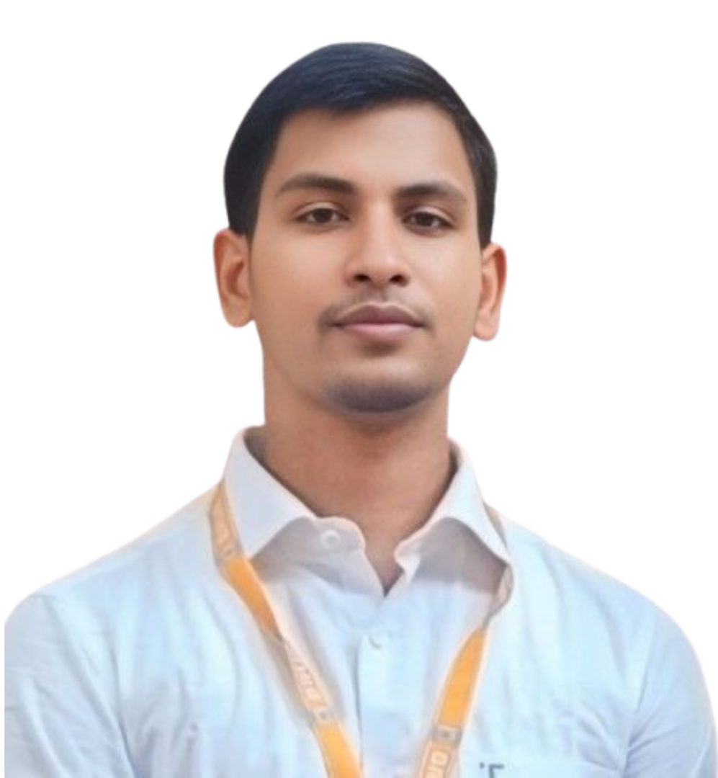





Md. Mozammel Haque
Aspiring Journalist | Content Writer
A master's journalism student at BRUR, skilled in media content creation, with strong communication, leadership, and a commitment to impactful journalism.
mhhridoybrur@gmail.com
01773-688987
BSMR Hall, BRUR, Rangpur
Apr 15, 2000
Mozammel.Hridoy1
mhhridoy87
EDUCATION
Bachelor of Social Science (BSS)
Begum Rokeya University, Rangpur
Major: Mass Communication and Journalism P. Year: 2023 CGPA: 3.61 out of 04
Higher Secondary Certificate (HSC)
Border Guard Public School and College, Rangpur
Year: 2019 Division: Science GPA: 4.25 out of 05
COMPETENCIES
Secondary School Certificate (SSC)
Sadakat Hossain High School, Rajibpur, Kurigram
Year: 2017 Division: Science GPA: 4.77 out of 05
Teamwork & leadership;
Content writing;
Research Report;
Presentation;
Event orgnizung;
Public Relations
EXPERIENCES
Campus Correspondent,
Daiily Desh Rupantor
Year: Jan 2023 (continuing)
Role:
Report on campus events.
Build networks to gather credible information.
Create engaging articles, interviews, and feature stories.
Skills
News Collection and Report Writing
(Professional Efficiency); Microsoft Office
(Professional Efficiency);
Photography
(Medium Efficiency);
Typing Speed (English): 35 wpm;
Social Media Marketing Manager
Mirage MCL
Year: Mar 2023 – Dec 2023
Role:
Look after overall social media activities.
Client management.
Copywriting for client social media pages.
LANGUAGES
Bangla, English
(Written and Verbal);
Hindi
(Speaking and Listening);
Arabic
(Moderate Efficiency)
Sub Editor (Acting News Editor),
Kurigram Sangbad
Year: June 2024 (continuing)
Role:
Editing news content for accuracy and clarity.
Managing reporters and coordinating news assignments.
Developing engaging articles, headlines, and features.
INTERESTS
Reading;
Commentary;
National History ;
Travelling
EXTRA CURRICULAR ACTIVITIES
Founding President,
Communication and Journalism Club,
Begum Rokeya University, Rangpur
Year: 2024 (continuing)
REFERENCES
Md. Sarwar Ahmed,
Assistant Professor,
Begum Rokeya University, Rangpur
Contact No: +8801671-789847
Abdullah Al Tufael Al Ahmed,
PS to VC,
Bangabandhu Sheikh Mujibur Rahman Science and Technology University, Gopalganj
Contact: +8801740-376818
General Secretary (Acting),
Bangladesh Journalism Students Council,
Begum Rokeya University Wing
Year: 2024 (continuing)
Active Citizen,
Active Citizens – British Council,
CCD Bangladesh
Commentator
Shaheed Abu Sayeed Inter Department Football Tournament 2024,
Begum Rokeya University, Rangpur

